Slide 1
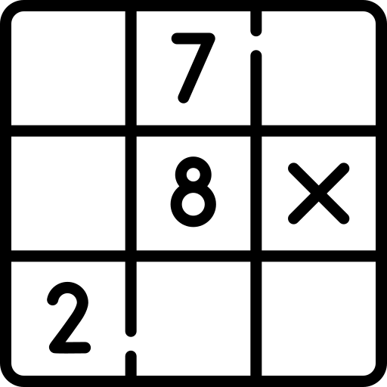
Sudoku solver
project
by Daniil Khlyvniuk

Slide 2
About me
Daniil Khlyvniuk
22 years old
3+ years of commercial experience in Fullstack web development
My stack:
JS / Node.js
React / Angular
Nest.js / express
Third year as a software engineering student

Slide 3

Project description
This is the web service for solving sudoku
Upload your image, pass a link or select default image for test
Get a result image with filled sudoku
Saving user input history
Gets some stats, charts, info about my dijit classifier model
Why sudoku?
Opportunity to implement “CV” part
Opportunity to implement my custom dijit classifier model
A lot of go-to information, guides, tutorials about dijit classifier model
Simple usage as a web service

Slide 4

Frontend
UI
User’s input
Display:
Result sudoku image
Users history
Model’s stats

Slide 5

Database api
Save user to db
Save user’s sudokus to db
Save user’s images to S3 bucket

Slide 6

AI api
Trains model for detection digits
Saves and contains model for detection digits
Processing sudoku images
Resolving sudokus
Creating resolved sudoku image

Slide 7

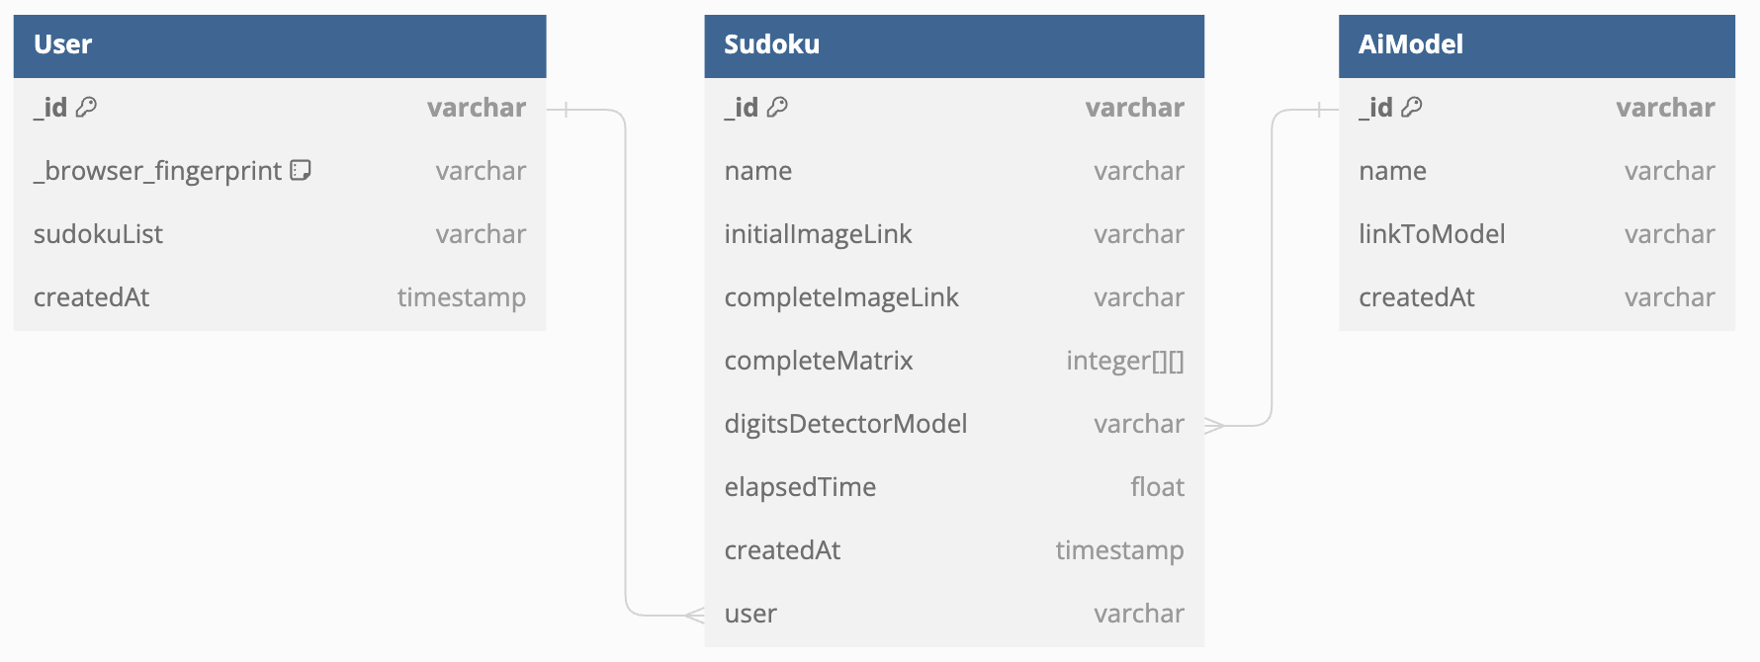
Database

Slide 8






























Application architecture and technology stack
Frontend | database-backend | ai-backend | services / tools

Slide 9
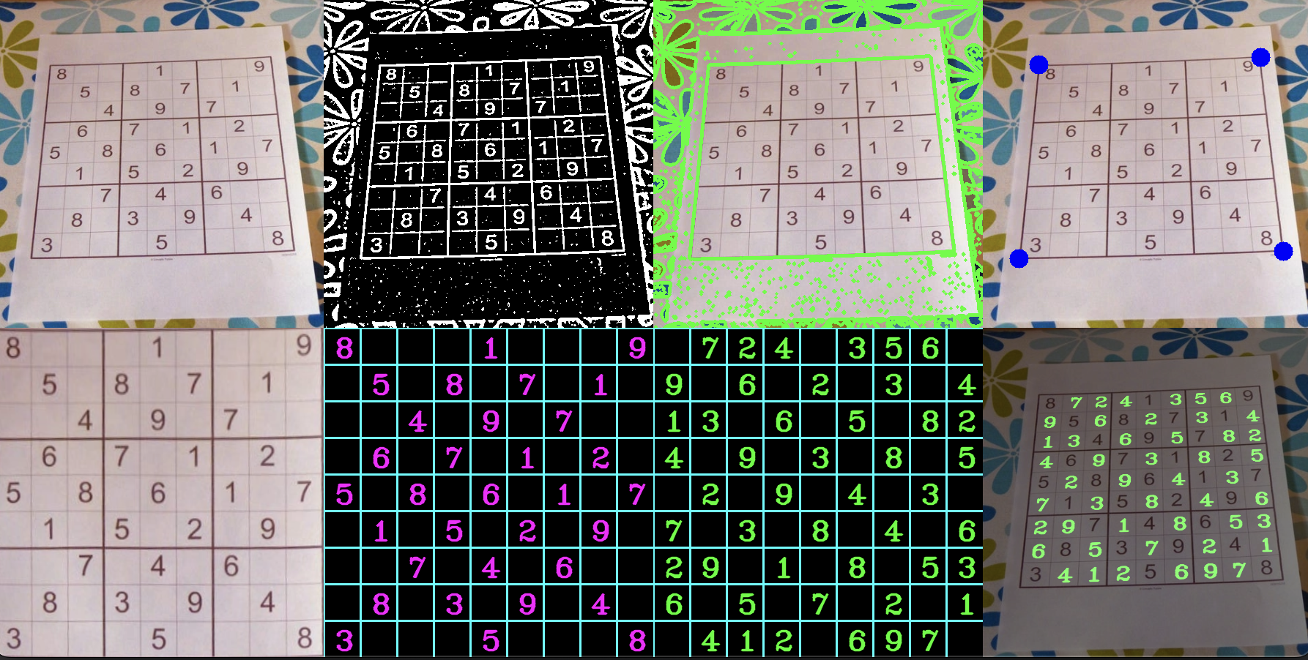
Detect numbers flow
Detect the sudoku game (the biggest squared contour)
Get corner point
Aligned perspective
Split every single field
Process every single field
Detect a number on the field

Slide 10
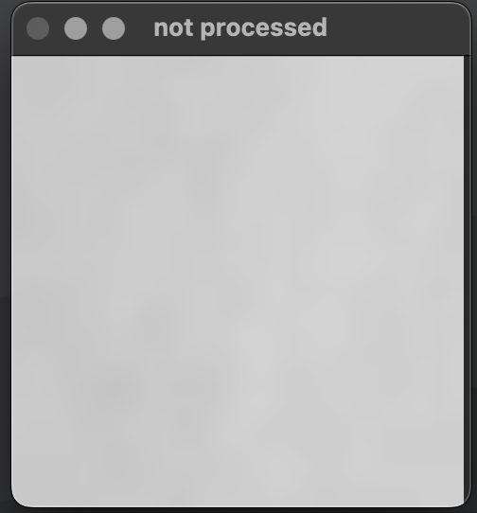
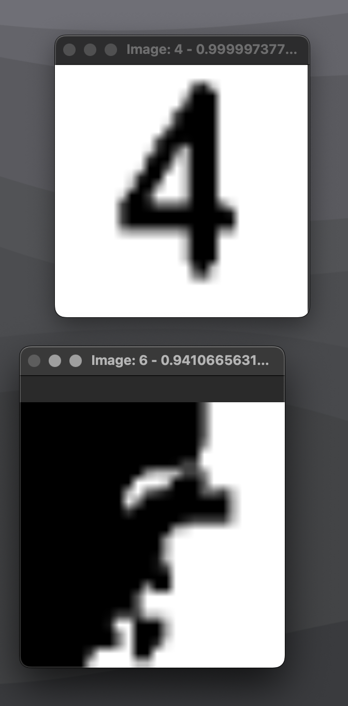
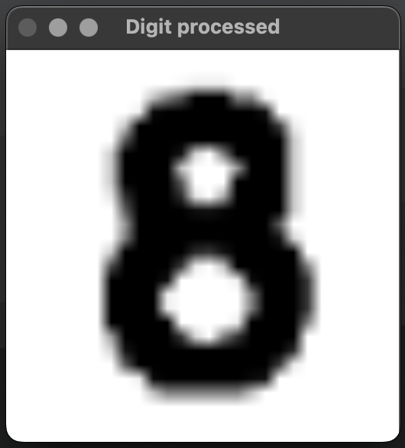
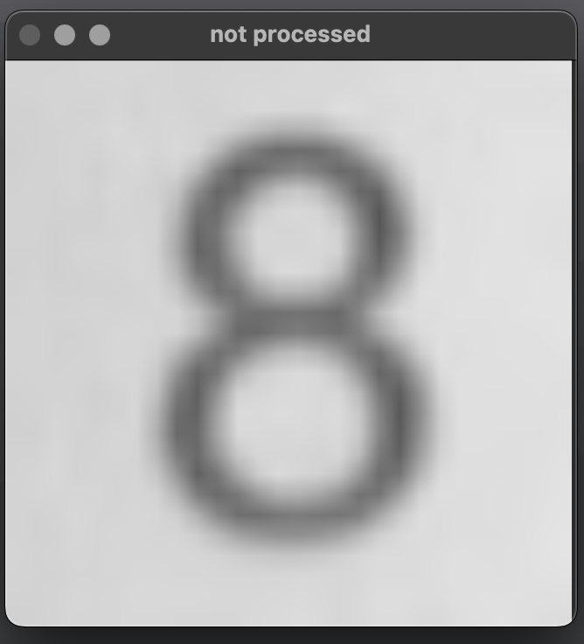
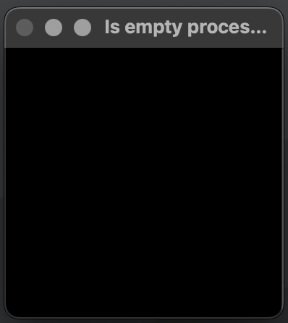
Number image processing
initial images:
Processed
8
empty (“0”)
8
4
empty (“0”)
cv2.morphologyEx()
Processing for “is_empty” check
cv2.threshold()
cv2.Canny()
empty (“0”)

Slide 11
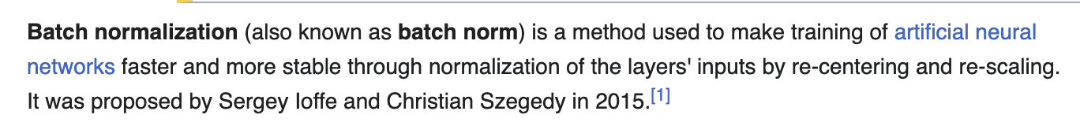
Digit classifier model (first try)
def create_model():
created_model = Sequential()
created_model.add(Conv2D(32, kernel_size=3, activation='relu', input_shape=(28, 28, 1)))
created_model.add(BatchNormalization())
created_model.add(Conv2D(32, kernel_size=3, activation='relu'))
created_model.add(BatchNormalization())
created_model.add(Conv2D(32, kernel_size=5, strides=2, padding='same', activation='relu'))
created_model.add(BatchNormalization())
created_model.add(Dropout(0.4))
created_model.add(Conv2D(64, kernel_size=3, activation='relu'))
created_model.add(BatchNormalization())
created_model.add(Conv2D(64, kernel_size=3, activation='relu'))
created_model.add(BatchNormalization())
created_model.add(Conv2D(64, kernel_size=5, strides=2, padding='same', activation='relu'))
created_model.add(BatchNormalization())
created_model.add(Dropout(0.4))
created_model.add(Conv2D(128, kernel_size=4, activation='relu'))
created_model.add(BatchNormalization())
created_model.add(Flatten())
created_model.add(Dropout(0.4))
created_model.add(Dense(10, activation='softmax'))
created_model.compile(optimizer=Adam(learning_rate=0.001), loss='categorical_crossentropy', metrics=['accuracy'])
return created_model

Slide 12
Improved second try
def create_model():
model = Sequential()
model.add(Conv2D(32, kernel_size=(3, 3), activation='relu', input_shape=(28, 28, 1)))
model.add(BatchNormalization())
model.add(Conv2D(64, (3, 3), activation='relu'))
model.add(BatchNormalization())
model.add(MaxPool2D(pool_size=(2, 2)))
model.add(Dropout(0.25))
model.add(Flatten())
model.add(Dense(128, activation='relu'))
model.add(BatchNormalization())
model.add(Dropout(0.5))
model.add(Dense(10, activation='softmax'))
model.compile(
loss=categorical_crossentropy,
optimizer=Adam(learning_rate=0.001),
metrics=['accuracy']
)
return model

Slide 13
Final digit classifier model
def improved_model():
model = Sequential()
model.add(Conv2D(32, kernel_size=(3, 3), activation='relu', input_shape=(28, 28, 1)))
model.add(Conv2D(64, (3, 3), activation='relu'))
model.add(MaxPooling2D(pool_size=(2, 2)))
model.add(Dropout(0.25))
model.add(Conv2D(128, (3, 3), activation='relu'))
model.add(BatchNormalization())
model.add(MaxPooling2D(pool_size=(2, 2)))
model.add(Dropout(0.25))
model.add(Flatten())
model.add(Dense(512, activation='relu'))
model.add(BatchNormalization())
model.add(Dropout(0.5))
model.add(Dense(10, activation='softmax'))
model.compile(optimizer=Adam(learning_rate=0.001), loss='categorical_crossentropy', metrics=['accuracy'])
return model
COUNT_CLASSES = len(DATASET_CLASSES) # 10
TEST_RATIO = 0.2
VALIDATION_RATIO = 0.3
RANDOM_STATE = 42
BATCH_SIZE = 30
EPOCHS = 24
# steps_per_epoch = len(x_train) // BATCH_SIZE

Slide 14


Oh, shoot . . .

Slide 15
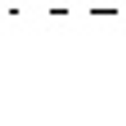

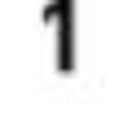

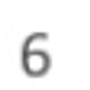

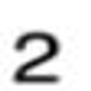

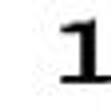
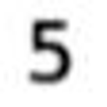
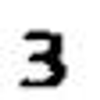




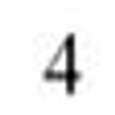



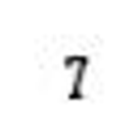
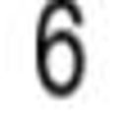
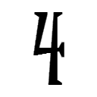
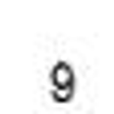

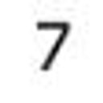

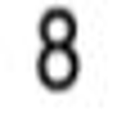

Dataset example
10 classes ~1600 each class
“0” ~ 642 items
“1” ~ 1 864 items
“2” ~ 1 767 items
“3” ~ 1 622 items
“4” ~ 1 647 items
“5” ~ 1 609 items
“6” ~ 1 543 items
“7” ~ 1 705 items
“8” ~ 1 577 items
“9” ~ 1 582 items
from keras.preprocessing.image import ImageDataGenerator
data_gen = ImageDataGenerator(
width_shift_range=0.2,
height_shift_range=0.2,
zoom_range=0.2,
rotation_range=20,
)
COUNT_CLASSES = len(DATASET_CLASSES) # 10
TEST_RATIO = 0.2
VALIDATION_RATIO = 0.3
RANDOM_STATE = 42
BATCH_SIZE = 30
EPOCHS = 24
# steps_per_epoch = len(x_train) // BATCH_SIZE

Slide 16

Questions 🤔
¿¿¿ Any questions ???

Slide 17
Links, articles, docs, etc.
Theailearner
Kaggle
OpenCV docs
Tenserwlow python docs
One of datasets
React docs
NestJS docs
Mongodb docs
Mongoose ODM docs
FastAPI docs
Amazon S3 bucket docs
Python3 docs

Slide 18
Links
source code
will be deployment link (if it’s done)

Slide 19

Good bye 👋!
Thanks for your attention!

